Slide 1
FACIAL RECOGNITION
Trisia Baltazar & Ryan Smith

Slide 2
AGENDA
WHAT IS FACIAL RECOGNITION
TECHNOLOGY BEHIND IT
HOW IT’S USED BY GOVERNMENTS
PROS / CONS
METHODS TO AVOID FACIAL RECOGNITION
METHODS TO PREVENT AVOIDANCE

Slide 3
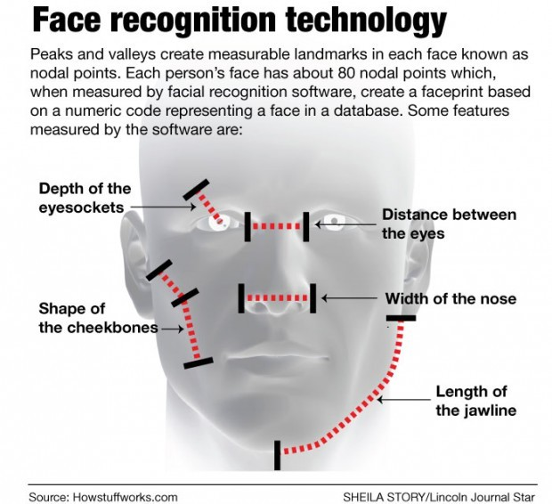
WHAT IS FACIAL RECOGNITION

Slide 4
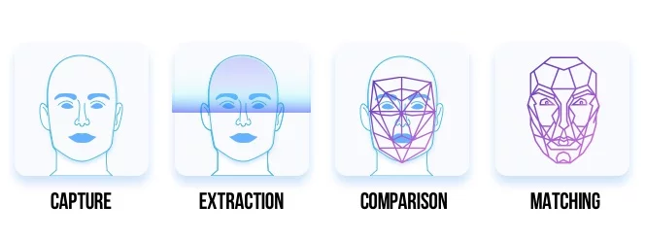
TECHNOLOGY BEHIND IT
Step 1: Capture & Extraction
Capture the image
Extract the face from the image

Slide 5
TECHNOLOGY BEHIND IT
Step 2: Comparison
Measure the curves of the face and distinct nodal points and creates a faceprint to compare to other faceprints in the database
Step 3: Matching
Match the face to the database and verify that it matches only one face in the database

Slide 6
GOVERNMENT USE

Slide 7
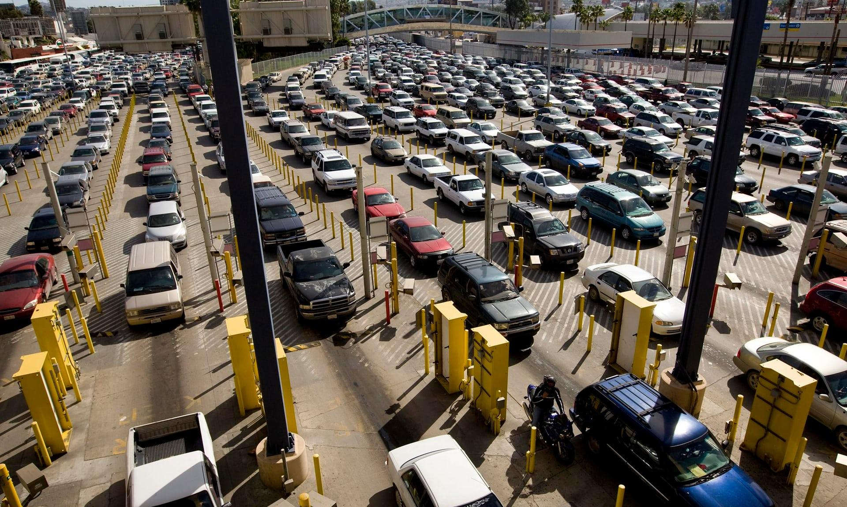
HOW IT’S USED IN US GOVERNMENT
Vehicle Face System - “Ability to capture a quality facial image for each occupant position in the vehicle” - These images are compared with those stored in “government holdings”, which include passports, visas, and other CBP documents
Notes:
The Vehicle Face System is a program being implemented on a stretch of the border between the United States and Mexico. This is a pilot program of sorts, it’s being used to test the systems ability to capture high quality images of people crossing the border. And it’s testing the systems ability to match these photos with people that are currently in the database. This program of course sparks privacy and constitutiuonal concerns.

Slide 8
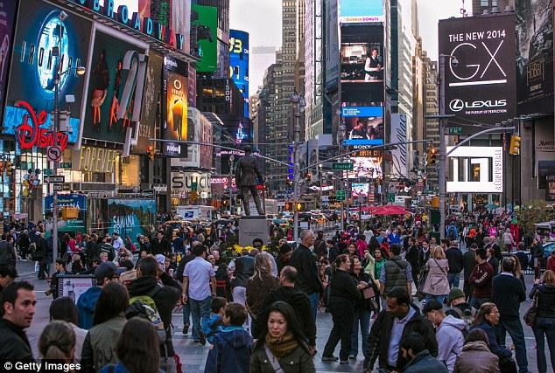
HOW IT’S USED IN US GOVERNMENT
FBI’s Next Generation Identification System uses a database of biometric information from criminal and civil sources
FBI’s FACE (Facial Analysis, Comparison, and Evaluation) Services Unit has access to NGI database as well as State Department’s visa and passport databases, the Defense Department’s biometric database, and the driver license databases of at least 16 states, totaling 411.9 million images
Notes:
The NGI is a massive biometrics database that includes more than facial recognition data. This data is gathered from civil and criminal sources. The FBI has access to a lot of data about people. There is a high probability that you are in one of the FBI’s facial recognition databases. Proposals that FBI released in 2015 indicated the agency planned to allow law enforcement officers to use mobile devices to collect face recognition data out in the field and submit that data directly to NGI.

Slide 9
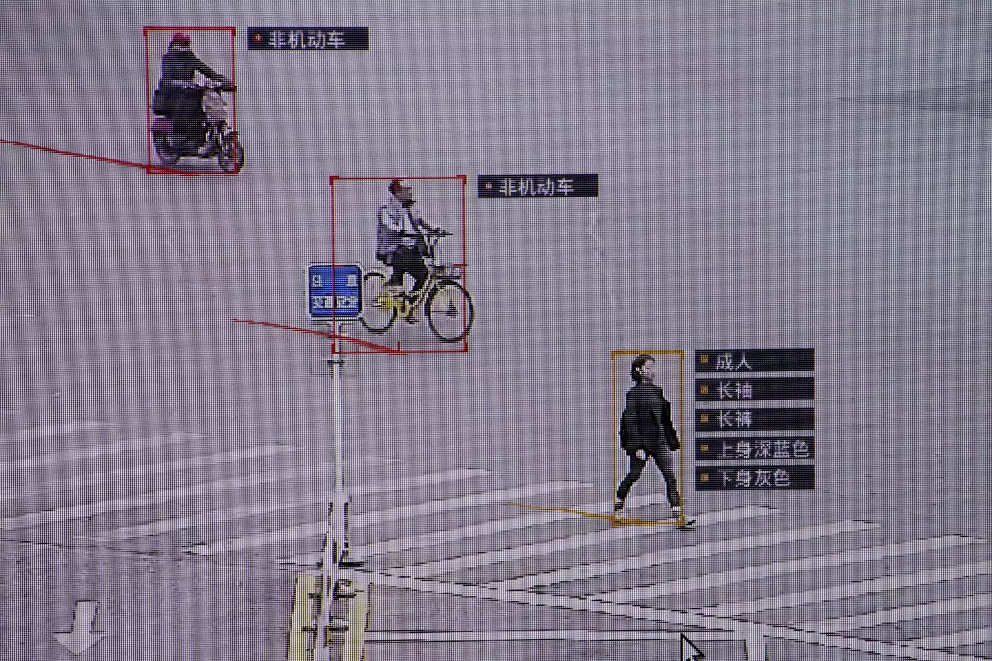
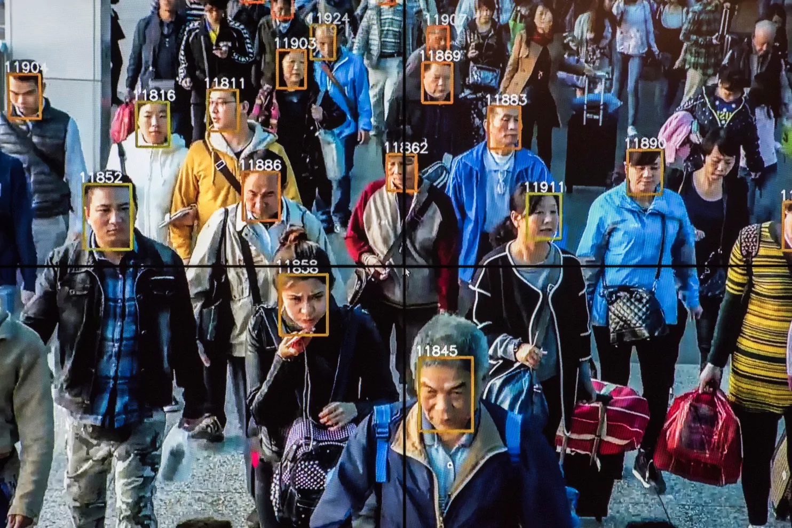
HOW IT’S USED IN CHINESE GOVERNMENT
Their initial goal was to identify jaywalkers

Slide 10
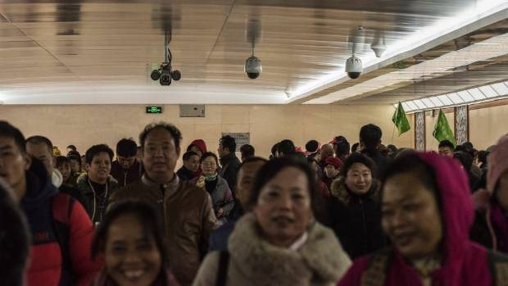
HOW IT’S USED IN CHINESE GOVERNMENT
As the technology proved more useful and advanced, they have expanded its capabilities to simple tasks such as using facial recognition for:
Unlocking apartment doors
Checking identities at ATMs and airports
Suspect tracking/ Crime monitoring

Slide 11

HOW IT’S USED IN CHINESE GOVERNMENT
Chinese man caught by facial recognition at pop concert
31 year old man wanted for “economic crimes” was found among a crowd of 600,000 people
He was caught at the ticket entrance
Shandong province arrested 25 suspects using a facial recognition system that was set up at the Qingdao International Beer Festival

Slide 12
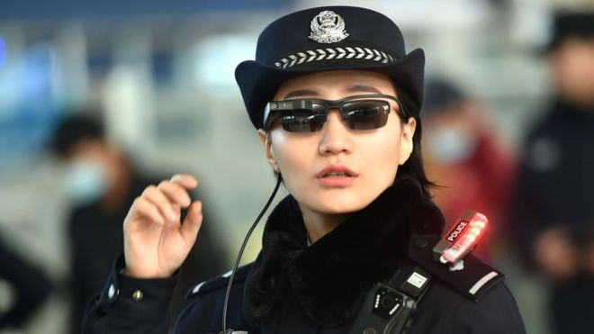
HOW IT’S USED IN CHINESE GOVERNMENT
Chinese police using surveillance sunglasses
The glasses are connected to an internal database of suspects, meaning officers can quickly scan crowds while looking for fugitives
People caught ranged from hit and runs to human trafficking

Slide 13
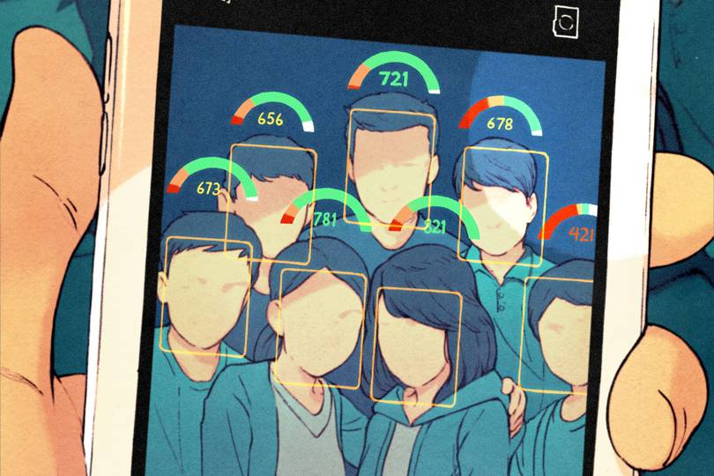
HOW IT’S USED IN CHINESE GOVERNMENT
Social Credit
Ultimate goal of determining the “trustworthiness” of the country’s 1.4 billion citizens
Social credit is preventing people from buying airline and train tickets, stopping social gatherings from happening, and blocking people from going on certain dating websites
Meanwhile, those viewed kindly are rewarded with discounted energy bills and similar perks

Slide 14
HOW IT’S USED IN CHINESE GOVERNMENT
Rewards include:
More Matches on dating sites
Discounted energy bills
Rent items without a deposit
Better interest rates in banks
Punishments include:
Blocked from buying domestic flights
Banned from buying plane/train tickets
Slow internet speeds
Ban you and/or your kids from the best schools
Limited job options
Being publically named as a bad citizen

Slide 15
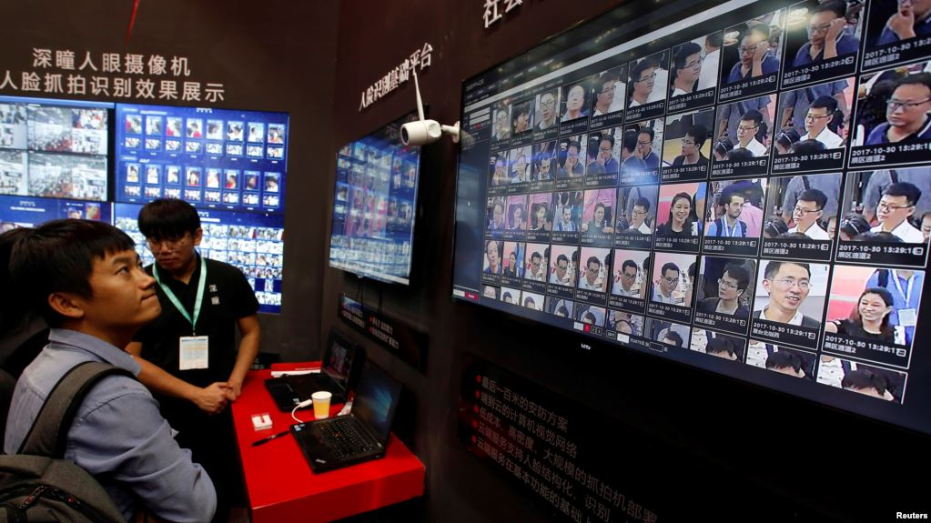
HOW IT’S USED IN CHINESE GOVERNMENT
By 2020…
Social Credit to be implemented nationwide
Currently have around 170 million CCTVs and plan to have 400 million more
China’s government aims to make the video surveillance network “omnipresent, fully networked, always working and fully controllable”

Slide 16
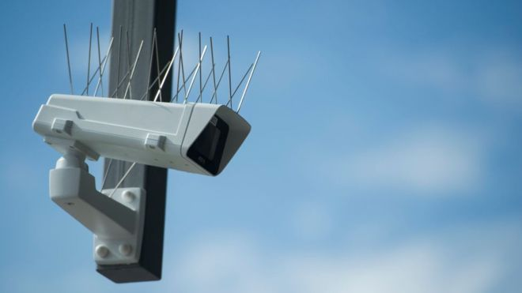
HOW IT’S USED IN CHINESE GOVERNMENT
“Omnipresent, fully networked, always working and fully controllable”
Guangdong-based Bell New Vision Co. is developing the nationwide "Sharp Eyes" platform that can link up public surveillance cameras and those installed in smart devices in the home, to a nationwide network for viewing in real time by anyone who is given access

Slide 17
WHAT’S GOOD WITH THE WAY IT IS BEING USED
Facial recognition is being used to identify fugitives and missing persons
It’s helping law enforcement agencies identify persons of interest from images
It allows subjects to be tracked from crime scenes
It’s reducing crime by performing automated surveillance at high-risk locations
Notes:
Governmental use of facial recognition sounds scary, but there are some great benefits. Fugitives or missing persons could be identified. A suspect captured on camera could be identified. It can be used to perform automated surveillance at high-risk locations. What that means is that if a person of interest comes into the cameras view someone can be notified.

Slide 18
WHAT’S WRONG WITH THE WAY IT IS BEING USED
Over collection of data
Unclear rules on the legal process required for collection
People don’t know when their data is captured and what it’s being used for
Future intentions are unknown
Notes:
While there are some pros there are definitely some cons. Specifically in America it is the FBI’s NGI database is not well documented to the public. Do you think that the government should be allowed to collect facial recognition data to populate its databases to track criminals when it was obtained from a civil source like a drivers license photo? You can’t know even know if you are in the database or not. The processes and data that is contained in databases like these need to be clear to the public.

Slide 19
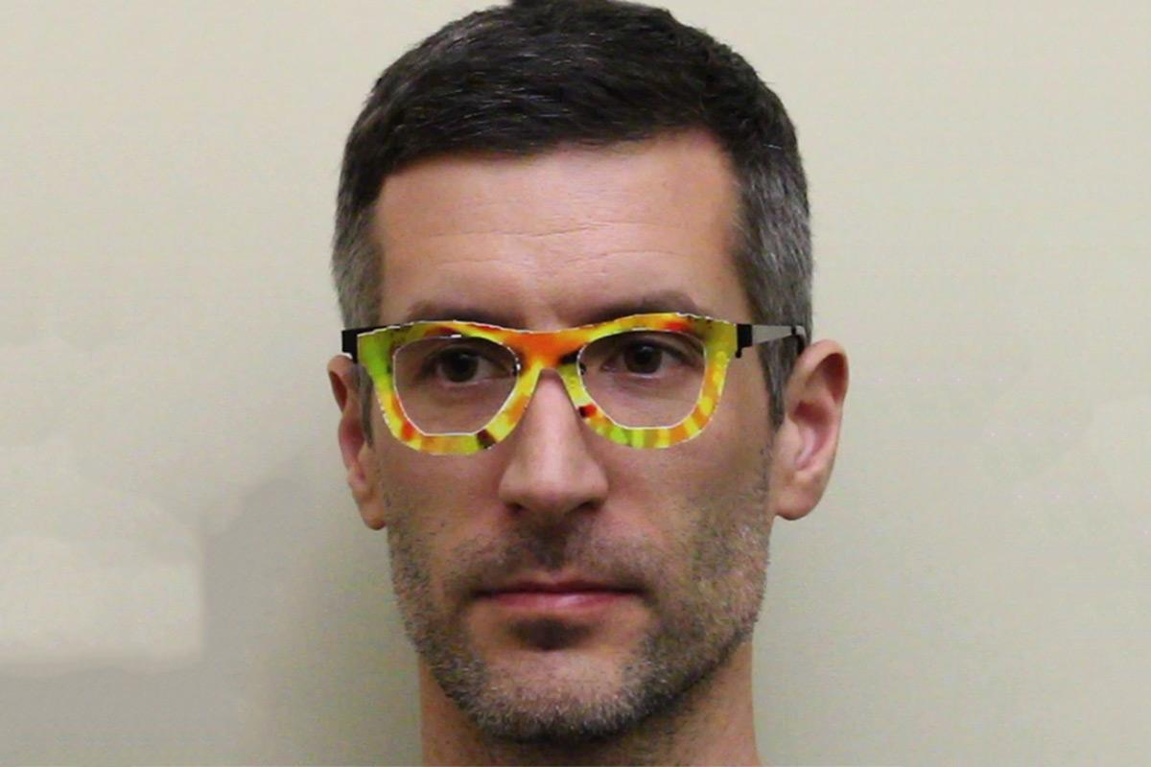
METHODS TO AVOID FACIAL RECOGNITION
Confuses facial recognition algorithms to avoid detection and allow impersonation
The algorithm will interpret the glasses as pixels and confuse them as being part of the face
Notes:
Now that we’ve talked about the good and bad of facial recognition. I’m going to discuss some methods to avoid it. This picture shows a guy wearing some silly glasses. These glasses actually work to confuse facial recognition algorithms and can even trick the system into thinking you are somebody that you aren’t. Basically the color blotches on the glasses trick the system into thinking they’re pixels and that they’re actually part of the face. This means it can’t identify who you actually are. These glasses are also 3d printed and are being made to be more inconspicuous.

Slide 20

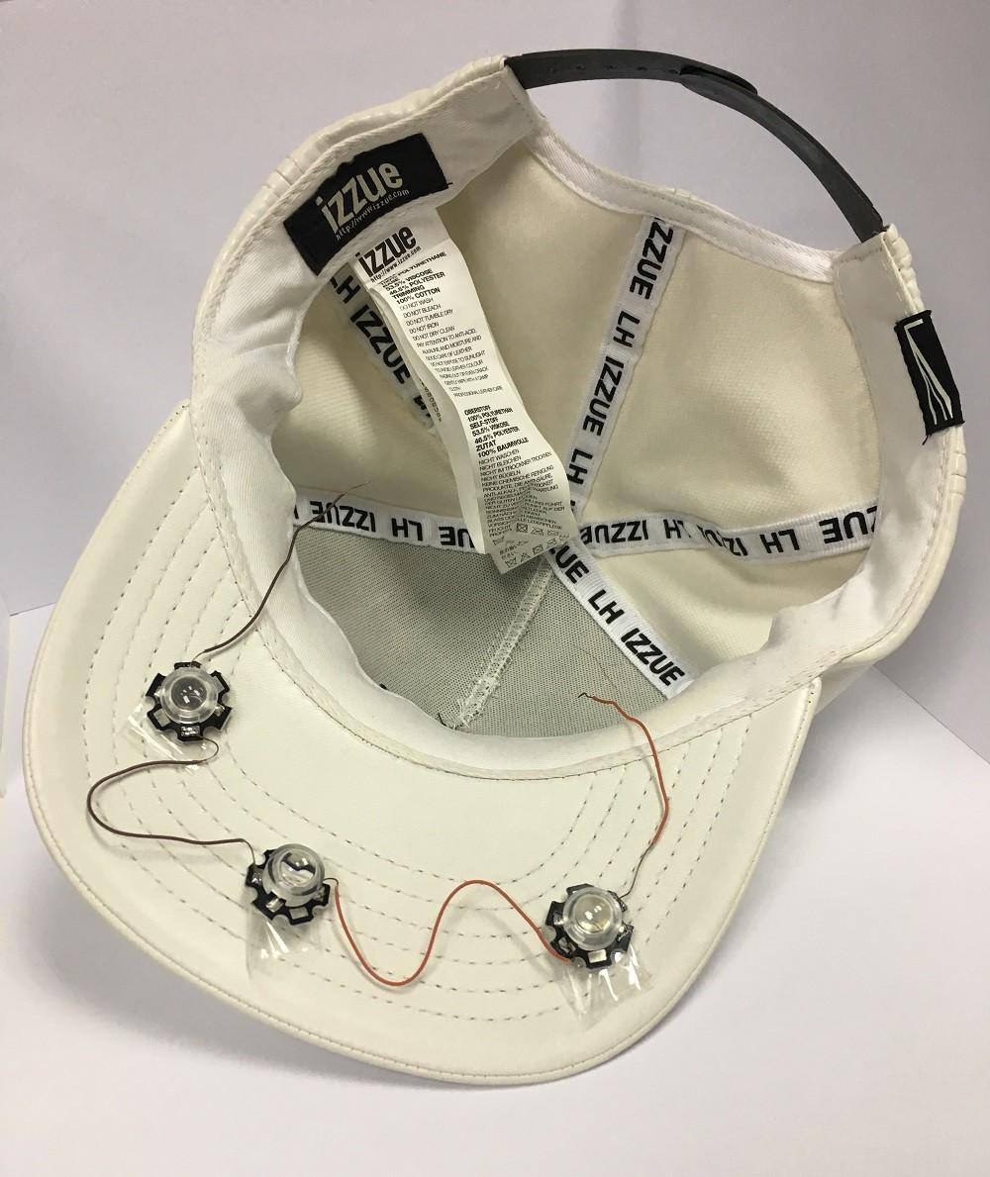
METHODS TO AVOID FACIAL RECOGNITION
Projects infrared LEDs to obscure the wearers identity
Can be used to impersonate a different person to pass facial recognition-based authentication
Notes:
This hat is lined with infrared LEDs that shine onto the face of the wearer. This light is invisible to the human eye but is captured by most cameras. Similar to the glasses this allows the wearer to confuse and trick facial recognition systems.

Slide 21
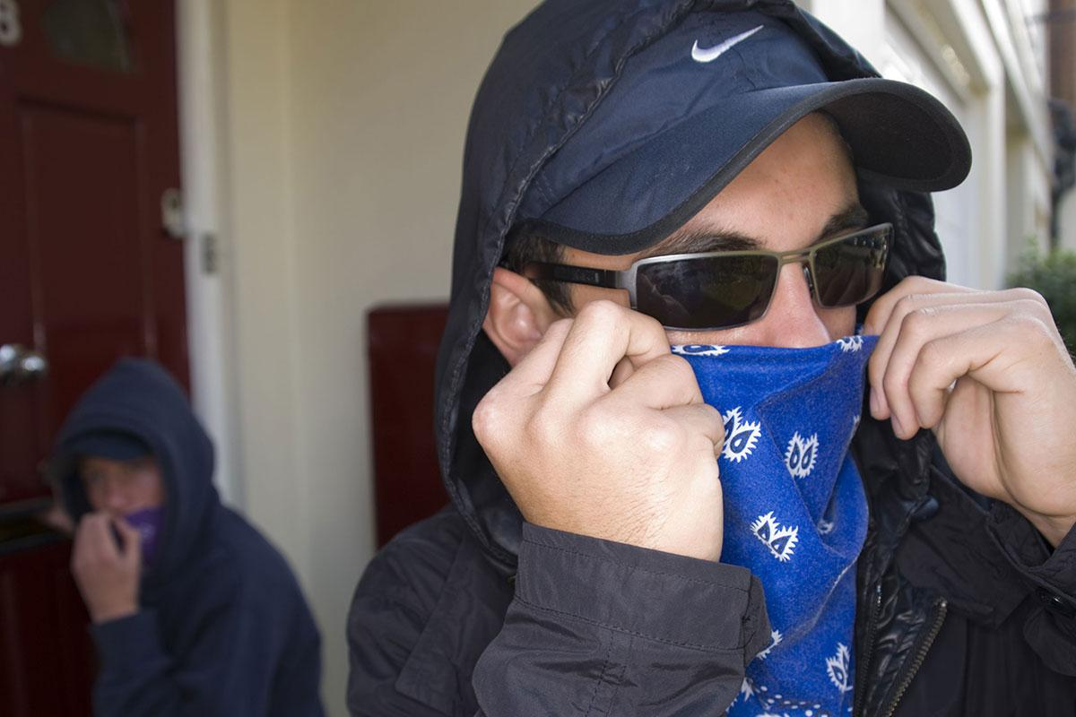
METHODS TO STOP AVOIDANCE
Machine learning algorithm selects 14 key points on a face
Accurately identified people
Wearing scarfs 77%
Cap and scarf 69%
Scarf and glasses 55%
Policies requiring the removal of all clothing/glasses/jewelry where facial recognition is being used
Notes:
Just as people are working on ways to avoid facial recognition systems people are working on ways to stop them. One algorithm in particular is especially effective at recognizing people even if they’re wearing clothing to obscure their face. It accomplishes this by estimating where the key points on the face would be under the clothing. And as you can see can accurately identify people at a surprising rate.

Slide 22
CONCLUSION
Facial recognition is a growing technology with great potential both good and bad. As this technology continues to grow specifically in the United States, we must be cautious and question the purpose we want facial recognition to serve.

Slide 23
QUESTIONS?

Slide 24
SOURCES
http://www.newsweek.com/jaywalking-china-facial-recognition-surveillance-will-soon-fine-citizens-text-861401
http://www.businessinsider.com/china-social-credit-system-punishments-and-rewards-explained-2018-4#1-banning-you-from-flying-or-getting-the-train-1
https://www.rfa.org/english/news/china/surveillance-03302018111415.html
http://i.dailymail.co.uk/i/pix/2014/09/15/1410799602339_wps_13_NEW_YORK_NY_OCTOBER_23_Cr.jpg
https://www.theguardian.com/technology/2018/jun/05/facial-recognition-us-mexico-border-crossing
https://www.eff.org/wp/law-enforcement-use-face-recognition#_idTextAnchor030
https://arxiv.org/pdf/1803.04683.pdf
https://www.newscientist.com/article/2111041-glasses-make-face-recognition-tech-think-youre-milla-jovovich/
http://www.dailymail.co.uk/sciencetech/article-5526885/Face-stealing-cap-uses-infrared-fool-facial-recognition-systems.html

